Slide 1
Sequence to Sequence Learning with Neural Networks
分享人：胡 军（hujun123qwe@163.com）

Slide 2
Overview
Introduction
Deep Learning + NLP = Deep NLP
Why not DNNs ?
Intuition in Seq2Seq
Brief in authors’ work
Seq2Seq Model
Machines Understand Natural Language
One-Hot Word Embedding
Language Model
RNN-LM
Double RNNs
LSTM-LM
Seq2Seq actual model
Experiments and Conclusion
Experiments details
Training Objective
Decoding
Training details
Conclusion
中英文翻译

Slide 3
Introduction

Slide 4
Deep Learning + NLP = Deep NLP
Word Embedding
Word2Vec [Mikolov et al. 2013](simpler and faster model)
Glove [Pennington et al. 2014 and Levy and Goldberg 2014]
RNNs
LSTM/GRU [Hochreiter & Schmidhuber, NeuComp ’97]
Sequence to Sequence Models [Sutskever et al., NIPS ’14]
Attention [Bahdanau et al., ICLR ’15]
Contextual Word Embedding
ELMo
OpenAI GPT
BERT

Slide 5
Deep Learning + NLP = Deep NLP
Word Embedding
Word2Vec [Mikolov et al. 2013](simpler and faster model)
Glove [Pennington et al. 2014 and Levy and Goldberg 2014]
RNNs
LSTM and GRU [Hochreiter & Schmidhuber, NeuComp ’97]
Sequence to Sequence Model [Sutskever et al., NIPS ’14]
Attention [Bahdanau et al., ICLR ’15]
Contextual Word Embedding
ELMo
OpenAI APT
BERT

Slide 6
Deep Learning + NLP = Deep NLP
Word Embedding
Word2Vec [Mikolov et al. 2013](simpler and faster model)
Glove [Pennington et al. 2014 and Levy and Goldberg 2014]
RNNs
LSTM/GRU [[Hochreiter & Schmidhuber, NeuComp ’97]
Sequence to Sequence Model [Sutskever et al., NIPS ’14]
Attention [Bahdanau et al., ICLR ’15]
Contextual Word Embedding
ELMo
OpenAI APT
BERT

Slide 7
Deep Learning + NLP = Deep NLP
Word Embedding
Word2Vec [Mikolov et al. 2013](simpler and faster model)
Glove [Pennington et al. 2014 and Levy and Goldberg 2014]
RNNs
LSTM/GRU [Hochreiter & Schmidhuber, NeuComp ’97]
Sequence to Sequence Model [Sutskever et al., NIPS ’14]
Attention/Self-Attention [Bahdanau et al., ICLR ’15]
Contextual Word Embedding (学习中）
ELMo
OpenAI APT
BERT

Slide 8
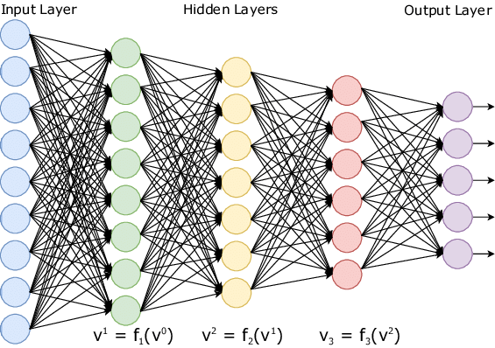
Why not Deep Neural Networks (DNNs) ?
Well done!
做得好！
No problem!
没有问题！
Please join us.
请加入我们。
Can I use your pen?
我能用你的笔吗？
限制了输入和输出向量的维度
对于一个给定的模型，我们只能被动的去构造固定维度的输入向量，得到固定维度的输出向量。
很多重要的问题由未知长度的序列表示
如语音识别，机器翻译，问答系统。

Slide 9
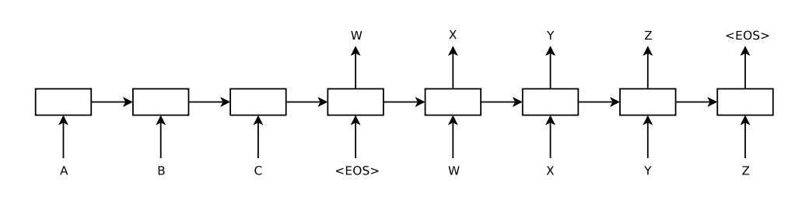
Intuition in Seq2Seq
Output Seq： WXYZ
Context
Hidden
State
LSTM Encoder
LSTM Decoder
Input Seq：ABC
Encoder-LSTM
处理输入序列并返回其隐藏状态。
Decoder-LSTM
给定目标序列的先前字符，预测目标序列的下一个字符。

Slide 10
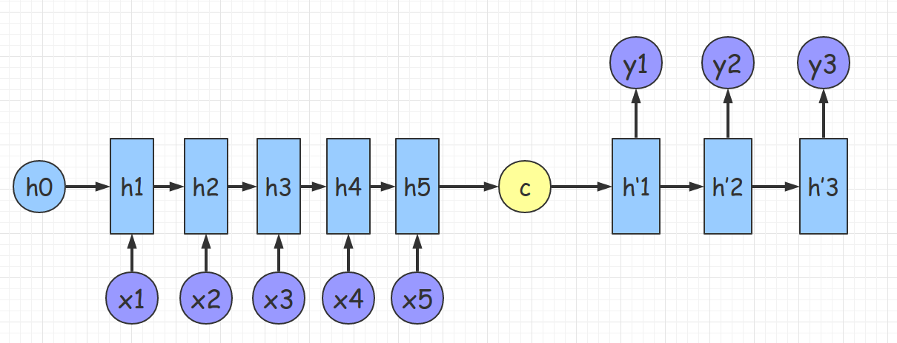
Intuition in Seq2Seq

Slide 11
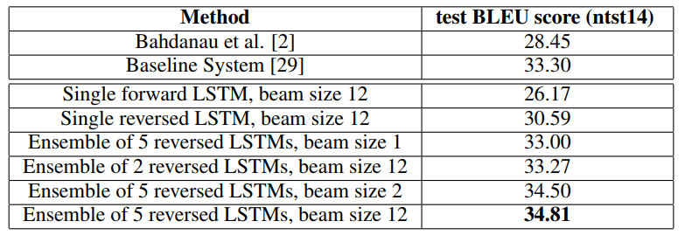
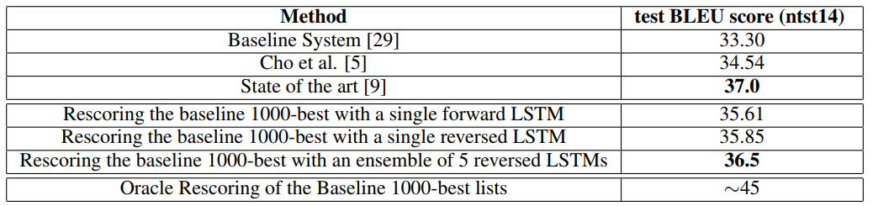
Brief in authors’ work

Slide 12
Seq2Seq Model

Slide 13
Machines Understand Natural Language
Step 1：Understand words
One-hot word embedding
Step 2：Understand string of words
Sequence to sequence model
Step 3：Have memory，logical reasoning
Augmented Logic and Arithmetic Components

Slide 14
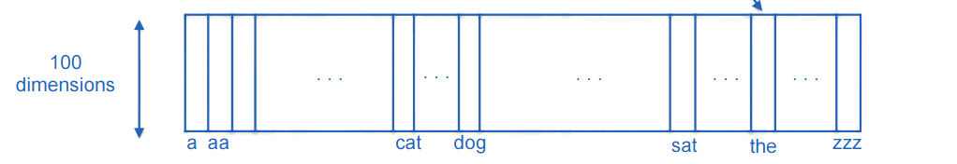
One-Hot
In vector space terms, this is a vector with one 1 and a lot of zeroes
例子：我，使用一个15维的向量表示

Slide 15
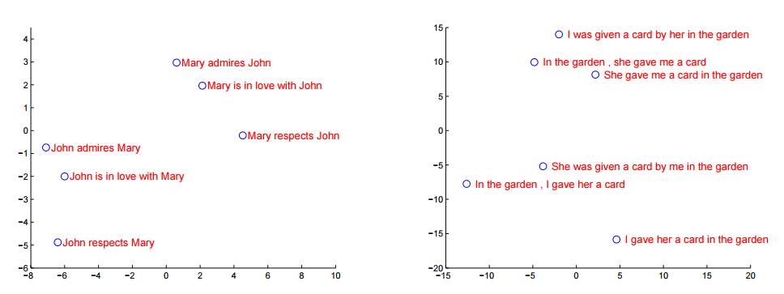
Word Embedding

Slide 16
Machines Understand Natural Language
Step 1：Understand words
One-hot word embedding
Step 2：Understand string of words
Sequence to sequence model
Step 3：Have memory，logical reasoning
Augmented Logic and Arithmetic Components

Slide 17


Language Model
给定一段文字长度T，其中词为$w_{1},w_{2},⋯w_{T}，$语言模型将计算该序列的概率：
计算方式：条件概率
如有四个单词的句子

Slide 18
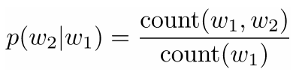
Language Model
例子：语音识别
厨房里食油用完了 VS 厨房里石油用完了
例子：机器翻译
you go first 翻译：“你走先” VS “你先走”
P(先|走）< P(走|先）

Slide 19
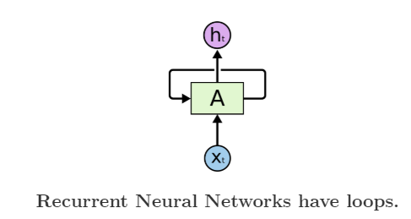
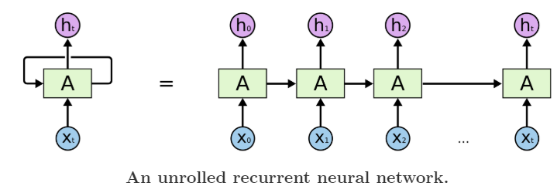
Recurrent Neural Networks (RNNs)
循环往复地把前一步的计算结果作为条件，放进当前的输入中
适合在任意长度的序列中对上下文依赖性进行建模。

Slide 20

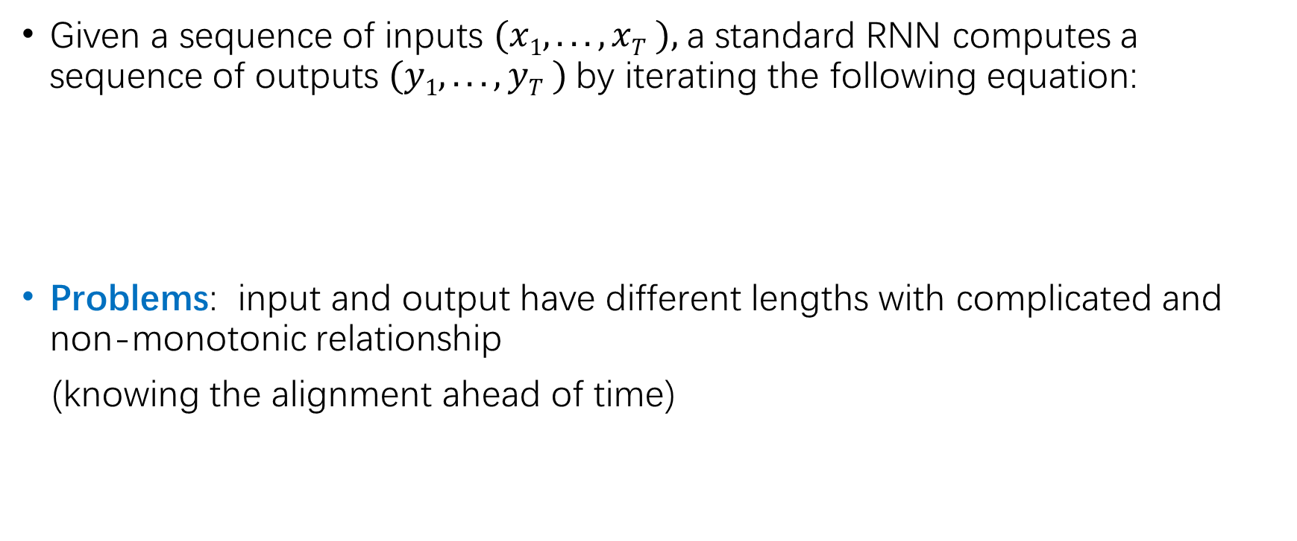
RNN-LM
Given a sequence of inputs $(x1, . . . , xT ),$a standard RNN computes a sequence of outputs $(y1, . . . , yT )$by iterating the following equation:
Problems: input and output have different lengths with complicated and non-monotonic relationship
(knowing the alignment ahead of time)

Slide 21
Double RNNs
One RNN maps the input sequence to a fixed-sized vector
Another RNN maps the vector to the target sequence
Problems: working in principle and hard to train（gradients vanish)
Introducing LSTM
Input
Fixed-sized vector
Target
One RNN
Another RNN

Slide 22
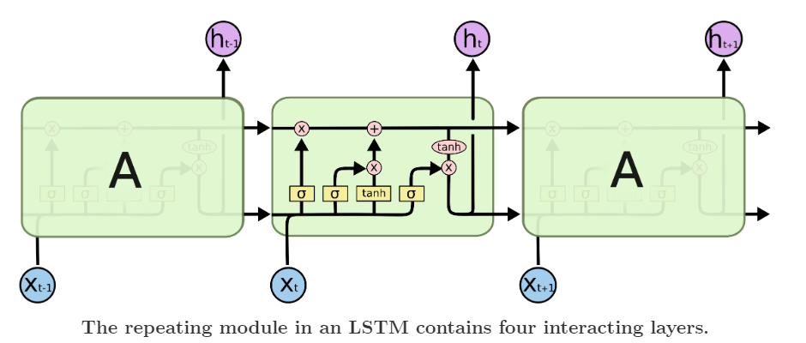
Long Short-Term Memory (LSTM)
http://colah.github.io/posts/2015-08-Understanding-LSTMs/

Slide 23
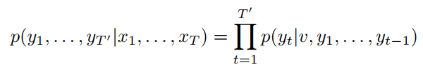
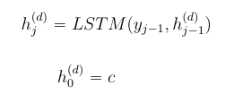


LSTM-LM
Estimate the conditional probability：
$v$ ：represent the $(x1, ⋯,xT )$given by the last hidden state of the LSTM

Slide 24
Actual Model
我
喜欢
狗
<eos>
1000 units
Hidden layer 4
Hidden layer 4
…
…
...
…
Context
Hidden
state
…
…
...
…
Hidden layer 3
Hidden layer 3
Hidden layer 2
Hidden layer 2
Hidden layer 1
Hidden layer 1
Word embedding
Word embedding
dogs
like
I
<sos>
我
喜欢
狗
Encoder LSTM
Decoder LSTM

Slide 25
Experiments and Conclusion

Slide 26
Experiments Details
Dataset Details
WMT’ 14 (Workshop on Statistical Machine Translation) EN2FR dataset.
12MB of 348MB French words and 304MB English words.
160,000 input words, 80,000 target words
Two Ways
Without using reference SMT system.
Statistical machine translation (SMT)
Rescore the 1000-best lists of an SMT baseline.

Slide 27


Training Objective
Training a large deep LSTM on many sentence pairs.
使用最大似然估计训练模型
左边S表示训练集，右边S表示输入
训练完成后根据LSTM找到概率最大的输出

Slide 28
Decoding
Beam Search (left-to-right) 选择最有可能的词
B 表示beam width(集束宽)，表示在每一次挑选top B的结果。
例子：共1000个词，B=3
a11
a1
a12
a
Discard all but the B most likely hypotheses
a13
···
a21
1000
b
a2
a22
a
a2
a23
a
···
a23
c
a3
a31
···
a32
a33

Slide 29
Training Details
使用4层LSTM（每层可以大约降低10%的复杂度）
每层1000个神经元，
构造了1000维的词向量，
16万输入，8万输出
380MB的参数，其中64MB纯循环连接参数（每个LSTM各32MB）
初始化参数在-0.08~0.08之间
共7.5个轮数，5个轮数后，每0.5轮数学习率减半
在每个批次训练中，找长度大致相同的句子
使用8个GPU运算，4个给LSTM，4个给softmax（1000X20000）

Slide 30
Actual Model
我
喜欢
狗
我
0.7
0.2
0.1
0.2
0.6
0.2
0.3
0.2
0.5
喜欢
狗
<eos>
1000 units
Hidden layer 4
Hidden layer 4
…
…
...
…
Context
Hidden
state
…
…
...
…
Hidden layer 3
Hidden layer 3
Hidden layer 2
Hidden layer 2
Hidden layer 1
Hidden layer 1
Word embedding
Word embedding
dogs
like
I
<sos>
我
喜欢
狗
Encoder LSTM
Decoder LSTM

Slide 31
Conclusion
作者认为如果提供足够多的训练数据，应该会在序列学习表现更好
逆序输入序列不仅可以提高准确率，而且可以翻译长的句子
作者相信如果逆序输入序列，标准的RNNs应该会比较好训练
作者一开始担心因为LSTM的记忆门限制，处理长句子会失败，可是居然成功了。
最重要的，作者直接使用了一个未用心优化的模型胜出了SMT系统。

Slide 32
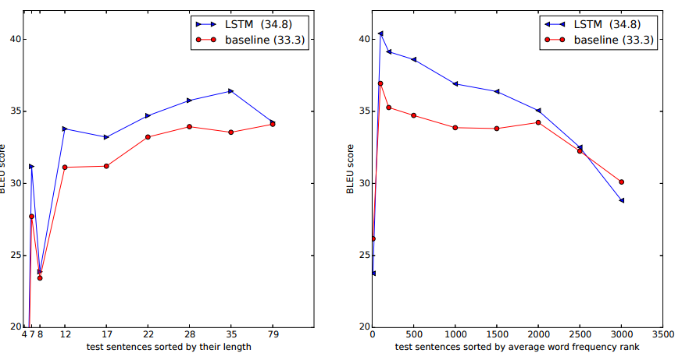
Conclusion

Slide 33
中英文翻译

Slide 34
中英文翻译
共21116行数据
训练100个epochs
每个epochs有8000词循环
使用MO平台GPU训练大概25分钟
最后损失 loss: 0.1039

Slide 35
Input sentence: It snowed.
Decoded sentence: 下雪了。
Input sentence: It's 3:30.
Decoded sentence: 3点半了。
Input sentence: It's cold.
Decoded sentence: 天很冷。
Input sentence: It's free.
Decoded sentence: 它是免費的。
Input sentence: It's late.
Decoded sentence: 很晚了。
Input sentence: Take care!
Decoded sentence: 照顾好自己。
Input sentence: Take care.
Decoded sentence: 照顾好自己。
Input sentence: Tom slept.
Decoded sentence: 汤姆睡了。
Input sentence: Tom swims.
Decoded sentence: 汤姆在笑。
Input sentence: Stand up.
Decoded sentence: 起立。
Input sentence: Grab that.
Decoded sentence: 抓住这个。
Input sentence: Grab this.
Decoded sentence: 抓住这个。
Input sentence: Hands off.
Decoded sentence: 手举起来。
Input sentence: He's a DJ.
Decoded sentence: 他是一个 DJ 。
Input sentence: Hold this.
Decoded sentence: 抱抱汤姆！
Input sentence: I'll swim.
Decoded sentence: 我要游泳。
Input sentence: Is it far?
Decoded sentence: 遠嗎？

